Slide 1
Exploring The Emerald City(Sydney)

Slide 2
INTRODUCTION:
Sydney is the capital city of NewSouthWales in Australia and also one of the most visited city in NSW.
It has many tourist spots like beaches,pools,harbour etc.
Visting such a big city is not easy so in this project i find the common venues that are nearby in the city and cluster those venues into different categories.

Slide 3
Data Acquistion and Cleaning:
In this project the data sets are extracted from foursquare api.
The data from foursquare api is in json file format.
Normalise the json file into pandas data frame.
Select the features that are required and drop remaining.
Drop the rows if any missing values are present.

Slide 4
Feature Selection:
The main features are venue name,latitude,longitude co-ordinates,category of the venue.
Add new column category_type to get better results.
Since the clustering is done based on the category_type.

Slide 5
Clustering Venues:
Cluster the venues using kmeans algorithm.
The clustering is done based on the category of the venue.
We got a total of 11 clusters out of which
a)Cluster-1 contains coffee shops.
b)Cluster-2 contains tourist spots.
c)Cluster-3 contains parks and pools.
d)Cluster-4 contains restaurants.
e)Cluster-5,Cluster-6 contains theaters,bars.
g)Cluster-7,Cluster8 contains fast foods,yoga studio and libraby.
h)Cluster-9,10,11 contains Dessert shops,accomodations and markets.

Slide 6
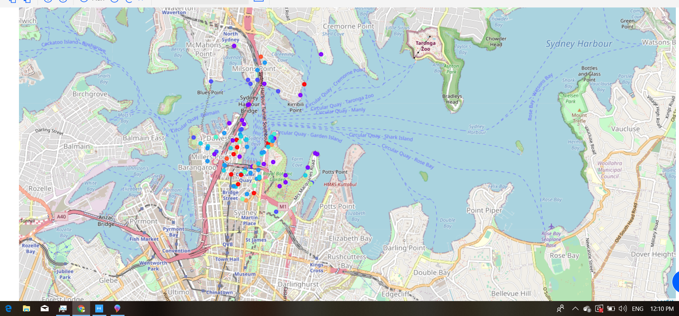
Folium Map:

Slide 7
Conclusions and Feature Directions:
It useful to the visitors who are going to visit sydney city.
In future you can calculate the distances from our hotel and also draw the directions.

